Slide 1
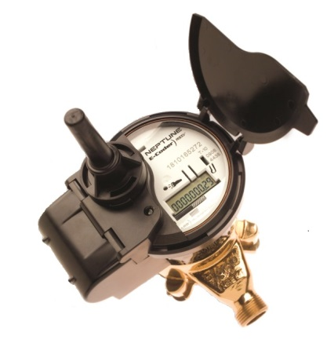
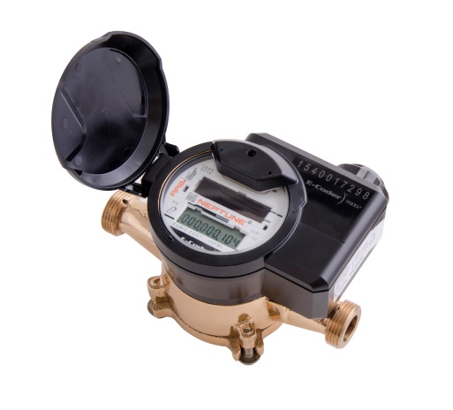

HOW TO READ YOUR R900i WATER METER
Your water meter is read at regular intervals for billing purposes. Should you wish to monitor your own consumption, here are the steps:
  Shine a flashlight over the register face to activate the LCD display*
  Take a reading at a set time of day
  Take a second reading at the same time the following day
  Subtract the first reading from the second reading to obtain your daily water consumption
*Note: when the register display is first activated via a flashlight, all digits and icons will be briefly displayed followed by software version information. The register display will toggle displaying the reading and then the flow rate alternating every 4 seconds. Older meter models (registers with external antenna) will display information for a predetermined amount of time and then the display will go blank. A flash of light will be required again to re-activate the display. Newer meter models (registers with internal antenna) require the flashlight to be held above the register solar panel for as long as the building owner would like the display to be on
Leak Indicator
Displays a possible leak
Flow Indicator
Displays water flow activity
.
OFF – indicates no leak
Flashing – water usage more than 50% of the time in last 24hr period
ON (Solid) – water usage continuous in the last 24 period, most likely a leak in your home
ON – water in use
OFF – water not in use
Flashing – very low flow
Negative – reverse flow
Positive – forward flow
The LCD displays your reading in cubic metres. The last 4 digits to the right of the decimal are fractions of a cubic metre. An increment of 1 in the last digit to the right represents 1/10th of a litre (100mL) change. This small amount of flow indication can also be used to help confirm leaks.

