Slide 1
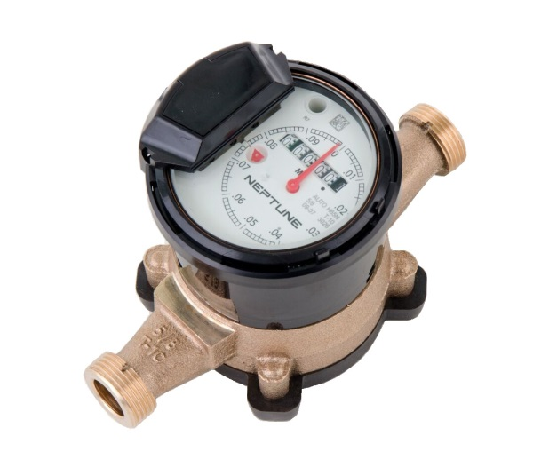
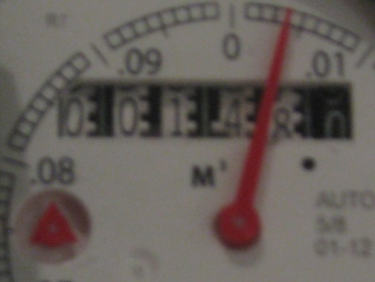
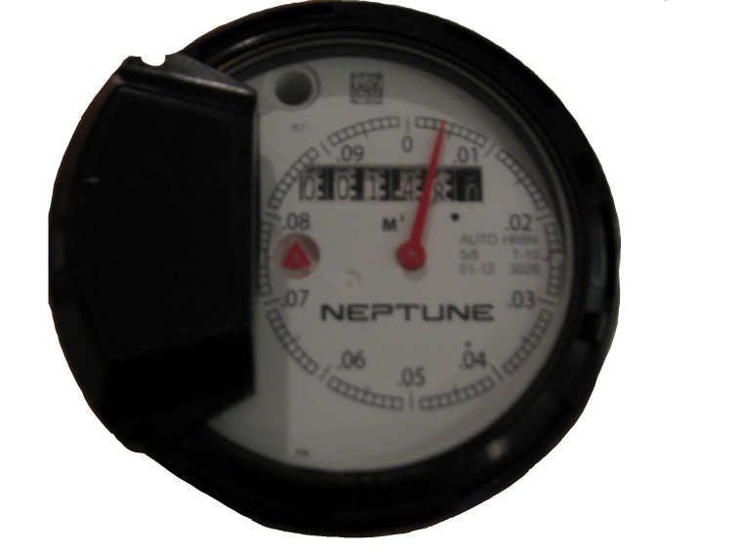
HOW TO READ YOUR PROREAD WATER METER
The Township of Southwold will read your water meter at regular intervals for billing purposes. Should you wish to monitor your own consumption, here are the steps:
  Take a reading at a set time of day
  Take a second reading at the same time the following day
  Subtract the first reading from the second reading to obtain your daily water consumption
Consumption on this meter is recorded in cubic metres. For residential water meters (5/8” to 1-1/2”), the odometer consists of 5 white wheels and 1 black wheel. The white wheels represent whole cubic metres while the black wheel represents tenths of a cubic meter. A decimal point is also printed on the dial face for reading convenience. Each sweep hand revolution represents 0.1 cubic metres (100 litres). There are 100 increments surrounding the sweep hand making each increment a volume of 1 litre.
Sweep Hand
Displays water flow activity
CLOCKWISE – water flowing into the home
COUNTER CLOCKWISE – water flowing out of the home or meter is installed backwards
A close-up of the register to the right would indicate a reading of 00148.004 or 148.004 cubic metres.
Leak Indicator
Movement of this triangle when all water fixtures in home are closed suggests a leak

