Slide 1
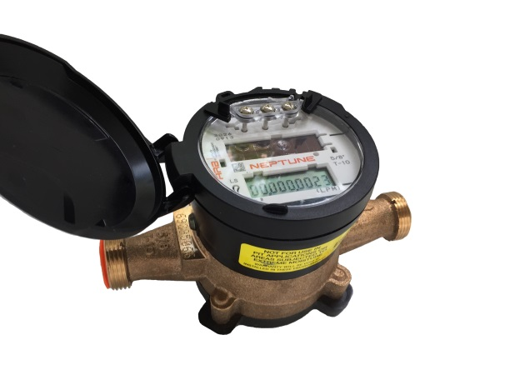
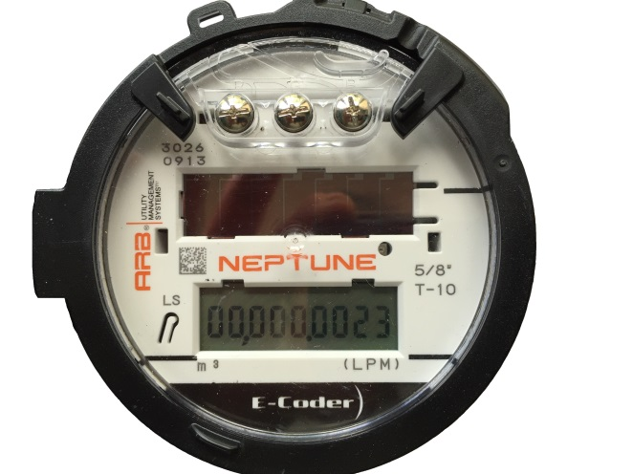

HOW TO READ YOUR ECODER WATER METER
The Township of Southwold will read your water meter at regular intervals for billing purposes. Should you wish to monitor your own consumption, here are the steps:
  Shine a flashlight over the solar panel above the display to activate the LCD screen*
  Take a reading at a set time of day
  Take a second reading at the same time the following day
  Subtract the first reading from the second reading to obtain your daily water consumption
*Note: when the register display is first activated via flashlight, all digits and icons will be briefly displayed followed by software version information. The register display will toggle displaying the reading (m3) and then the flow rate (li/m). To activate the display the homeowner is required to shine a flashlight above the register solar panel for as long as the homeowner would like the display to be on. Removal of the light will turn the display off and a flash of light will be required again to re-activate the display.
Leak Indicator
Displays a possible leak
Flow Indicator
Displays water flow activity
.
OFF – indicates no leak
Flashing – water usage more than 50% of the time in last 24hr period
ON (Solid) – water usage continuous in the last 24 period, most likely a leak in your home
The LCD displays your reading in cubic metres. The last 4 digits to the right of the decimal are fractions of a cubic metre (litres). The City bills consumption in whole cubic metres. An increment of 1 in the last digit to the right represents 1/10th of a litre (100mL) change. This small amount of flow indication can also be used to help confirm leaks.
ON – water in use
OFF – water not in use
Flashing – very low flow
Negative – reverse flow
Positive – forward flow

Slide 2

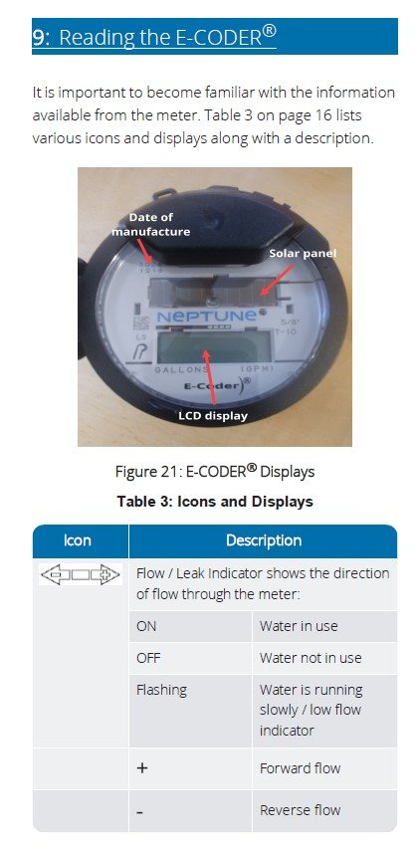

Slide 4
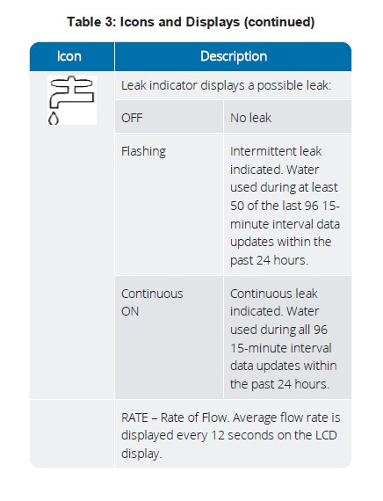

Slide 5
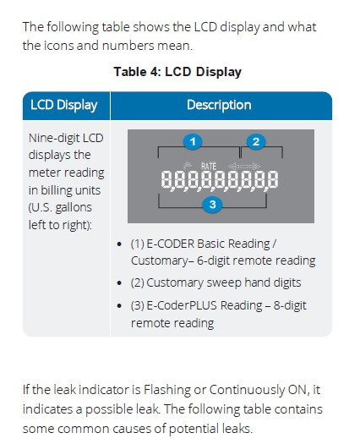

Slide 6
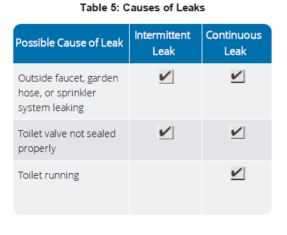

Slide 7
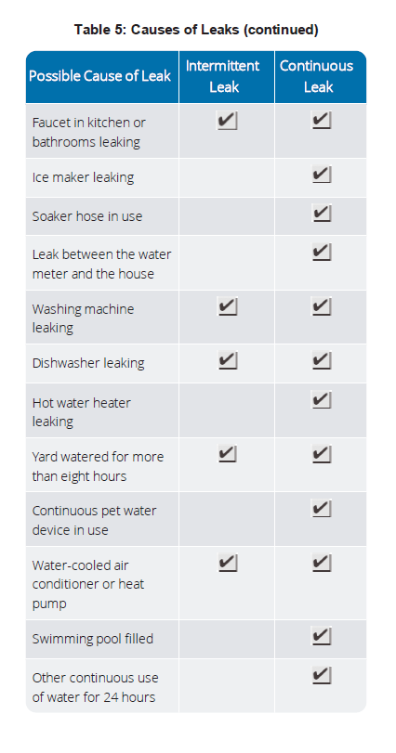

Slide 8
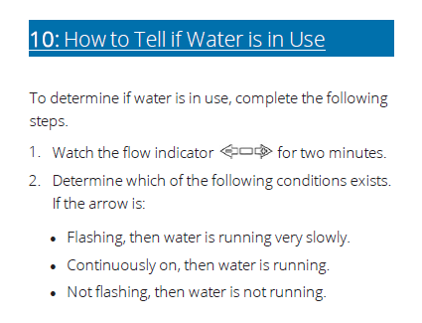

Slide 9
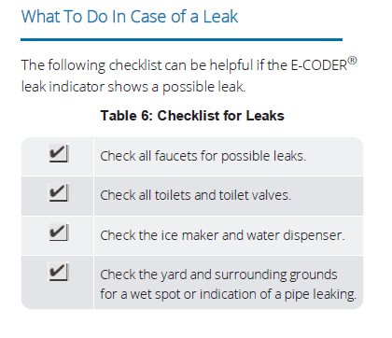

Slide 10
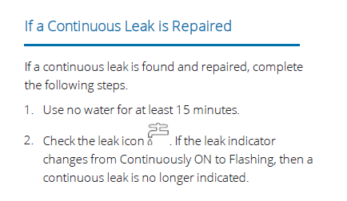

Slide 11
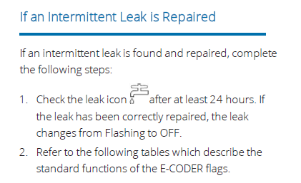

Slide 12
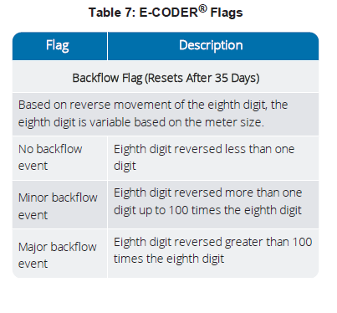

Slide 13
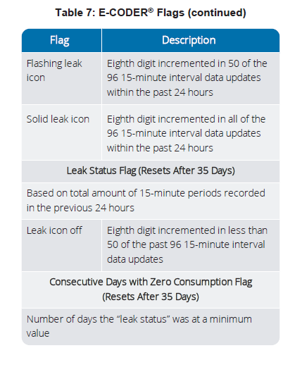

Slide 14
